Slide 1





Brand Awareness KPI by city
Brand Awareness (Guangzhou)
W3 Ranking (W2 Ranking)
6 (5) | 7 (6) | 8 (8) | 9 (9) | 10 (10)
TOMA
Total unaided awareness
Total aided awareness
Base: Respondents in Guangzhou, n=200
Sig. HIGH / LOW vs. last wave @ 90% C.L.

Slide 2

Brand Usage KPI by city
Brand Usage
(Guangzhou)
W3 Ranking (W2 Ranking)
6 (8) | 7 (7) | 8 (6) | 9 (9) | 10 (NA)
*
BUMO
P1M Usage
P3M Usage
Base: Respondents in Guangzhou, n=200 * New test brand since wave 3
Sig. HIGH / LOW vs. last wave @ 90% C.L.

Slide 3



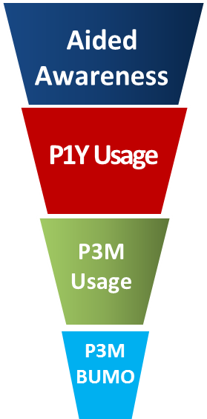
Brand Funnel KPI by city
Brand Funnel
(Guangzhou)
*
TOMA(Unaided) | 11% | 1% | 0% | 2% | 9%
Total Unaided Awareness | 24% | 7% | 2% | 7% | 25%
71% | 77% | 77% | 62% | 59%
0.79 | 0.81 | 0.82 | 0.89 | 0.80
56% | 62% | 63% | 55% | 47%
0.79 | 0.72 | 0.68 | 0.77 | 0.83
44% | 44% | 43% | 42% | 39%
0.19 | 0.05 | 0.02 | 0.14 | 0.15
9% | 2% | 1% | 6% | 6%
XX
XX
Top 2 performance
Bottom 2 performance
Base: Respondents in Guangzhou, n=200 * New test brand since wave 3
Sig. HIGH / LOW vs. last wave @ 90% C.L.

Slide 4
Data availability
Brand: Vitasoy, Vita Tea
City: Guangzhou, Wuhan, Shanghai, Beijing(since 2017W2)
Data Period: Around quarterly, starting from 2017(BJ data starts from 2017 W2)
Data source: Ipsos

